Slide 1
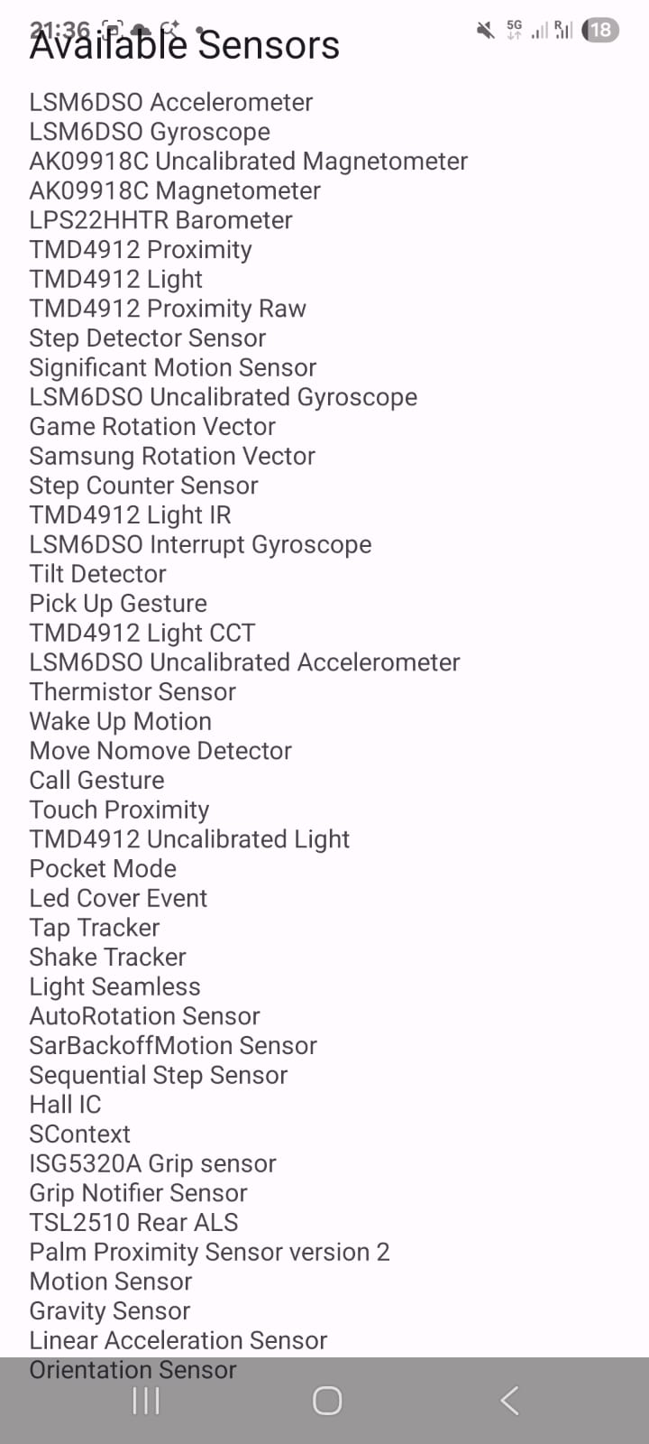
Programming Task - Android Sensors
Questions:
1. Submit a screenshot of the output!

Slide 2
Programming Task - Android Sensors
Question 2. Which sensor could be used to measure Parkinson’s disease?
1. Accelerometer to detect tremor
In diseases such as Parkinson's, an involuntary tremor is typical.
The accelerometer measures the frequency (how many times per second) and the amplitude (how strong): For example, a Parkinson's tremor often has a very characteristic frequency of about 4 to 6 Hz (oscillations per second).
The sensor signal allows algorithms to distinguish this tremor with crystal clarity from normal movements (such as drinking coffee or writing).
2. Accelerometer for gait analysis
Motor neuron diseases often cause muscles to weaken or coordination to decline. This alters the gait pattern.
When the patient carries the smartphone in their pants pocket or wears a sensor on their body, the accelerometer records the up-and-down as well as forward movements with every step.
What can be read from this: One can measure whether the steps become asymmetrical, whether the patient shuffles, how long the stance phase of a foot is, or whether short episodes of "freezing" (Freezing of Gait) occur.

